Slide 1
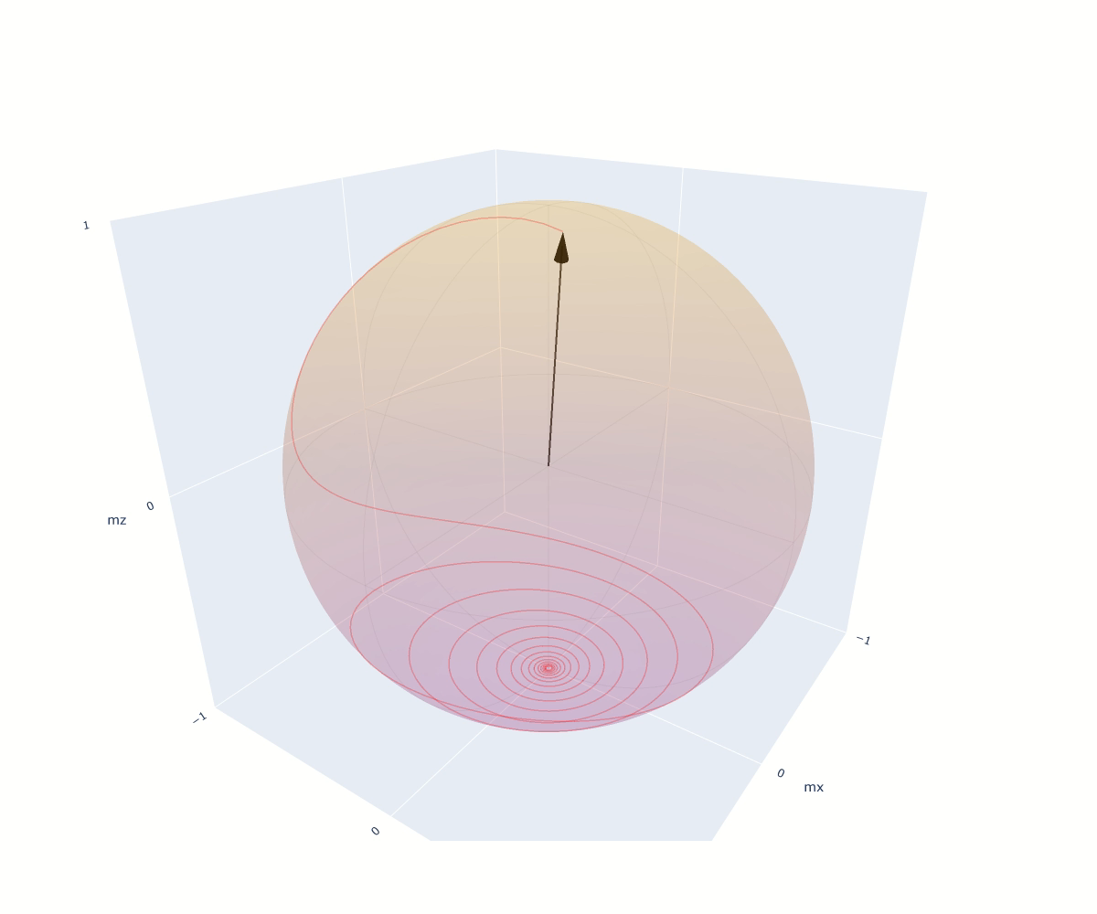
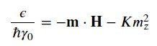
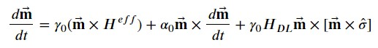
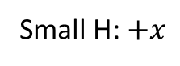
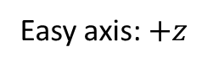
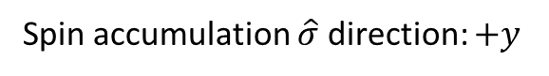
FM Magnetization Dynamics: Case I
Uniaxial anisotropy + small field
(to avoid unstable equilibrium):
Easy axis: $+z$
Small H: $+x$
2. Spin accumulation causes
anti-damping-like torque:
Spin accumulation $\hat{σ}$ direction: $+y$

Slide 2
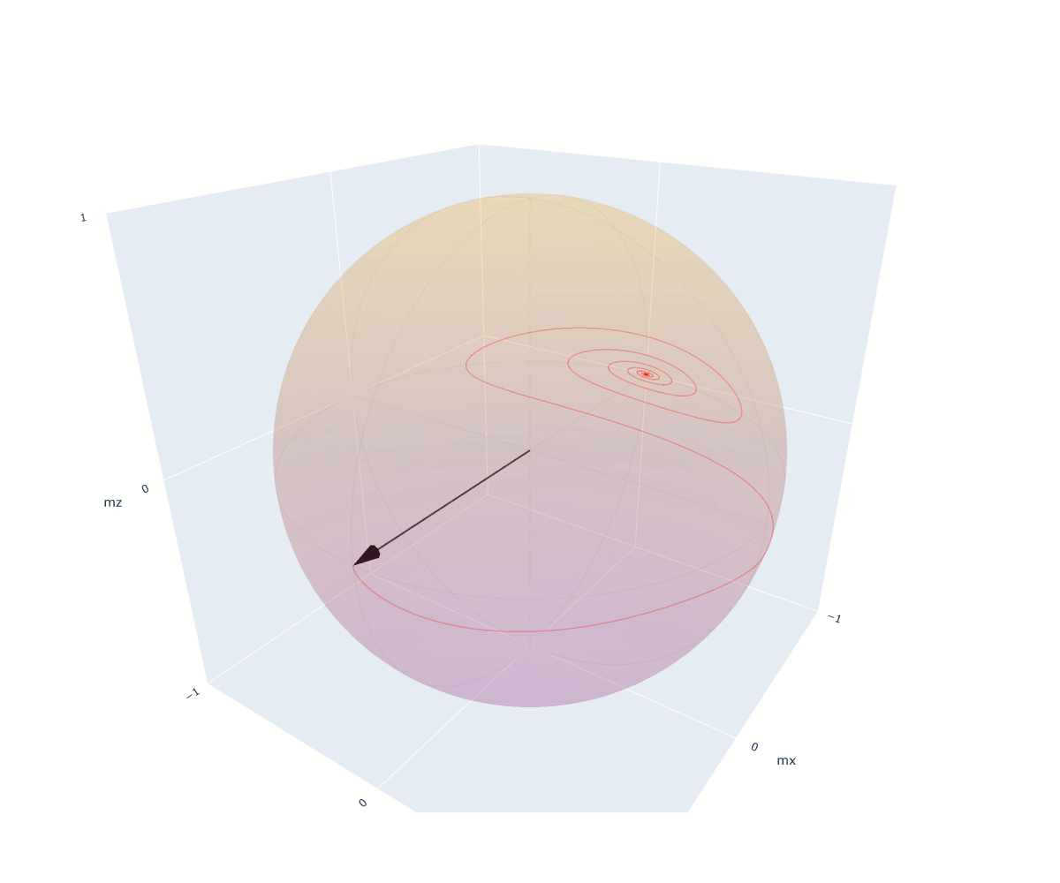
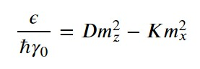
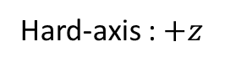
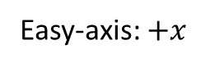
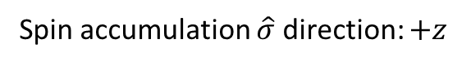
FM Magnetization Dynamics: Case II
Uniaxial anisotropy: Easy Plane + Easy Axis
Easy-axis: $+x$
Hard-axis : $+z$
(No External Field)
2. Spin accumulation causes anti-damping-like torque:
Spin accumulation $\hat{σ}$ direction: $+z$
Current is turned-off at a specific moment!

Slide 3
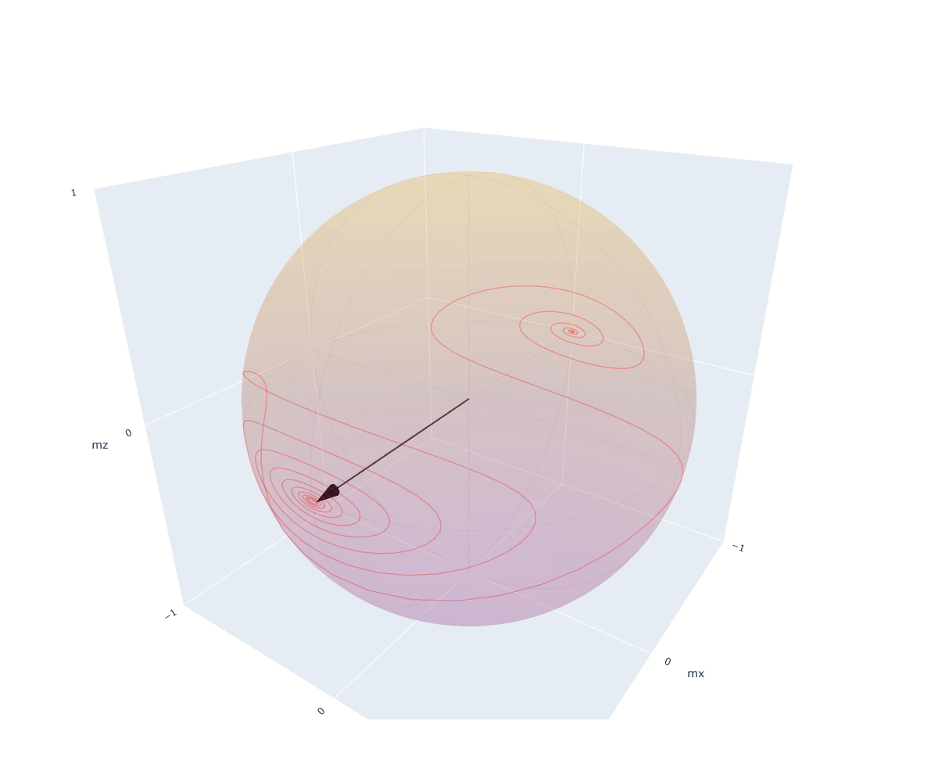
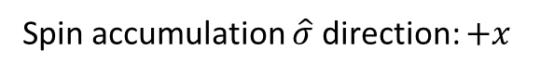
FM Magnetization Dynamics: Case III
Uniaxial anisotropy: Easy Plane + Easy Axis
Easy-axis: $+x$
Hard-axis : $+z$
(No External Field)
2. Spin accumulation causes anti-damping-like torque:
Spin accumulation $\hat{σ}$ direction: $+x$

